Slide 1


Bluejacking
Submitted By:
S.SRINIDHI R.M. RAMYA

Slide 2
Content
Introduction
Bluejacking Technology
Architecture
Technical Features
How to Bluejack
Usage of bluejacking
Related concepts
Future aspects
Conclusion
Reference

Slide 3

Introduction
Bluejacking
  Sending of unsolicited messages over Bluetooth to Bluetooth-enabled devices such as mobile phones, PDAs or laptop computers via the OBEX protocol.
Origin
  Started after a Malaysian IT consultant named “Ajack” posted a comment on a mobile phone forum.

Slide 4

Bluejacking Technology
Bluetooth technology
vCard
OBEX protocol

Slide 5

Architecture
Piconet
The devices find each other and form a network called “ piconet ” spontaneously.
A piconet is a basic unit with up to 8 nodes, one of which is a master and up to seven active slave nodes within a maximum distance of 10 meters.
All communication between master and slaves.
Piconet is a centralized TDM system.
Master controls clock and decides the time slot for the device.
In a piconet , there can be up to 255 parked nodes.
Master switches to low power state and parked node wait for beacon from master.

Slide 6
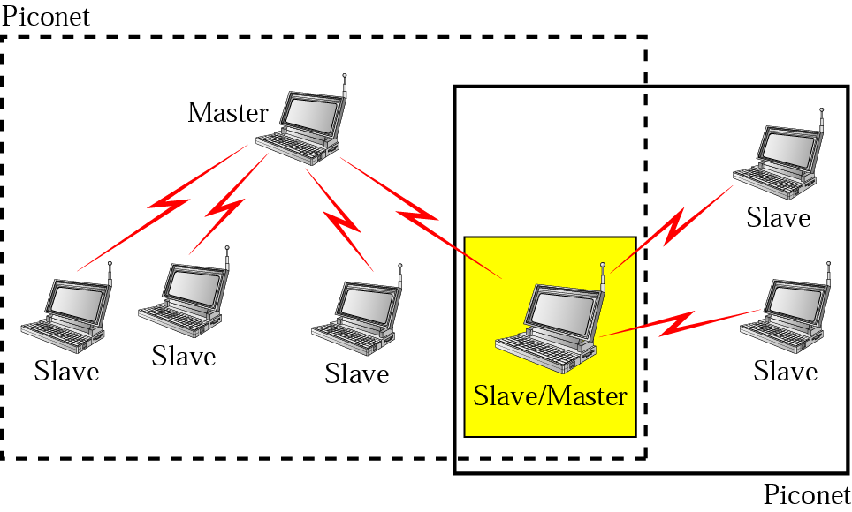

Slide 7

Technical Features
Connection Type | Spread Spectrum (Frequency Hopping) & Time Division Duplex (1600 hops/sec)
Spectrum | 2.4 GHz ISM Open Band (79 MHz of spectrum = 79 channels)
Modulation | Gaussian Frequency Shift Keying
Transmission Power | 1 mw – 100 mw
Data Rate | 1 Mbps
Range | 30 ft
Supported Stations | 8 devices
Data Security –Authentication Key | 128 bit key
Data Security –Encryption Key | 8-128 bits (configurable)
Module size | 9 x 9 mm

Slide 8
Classification
Classification of devices on the basis of Power dissipated & corresponding maximum Range.
 | POWER | RANGE
CLASS I | 20 dBm | 100 m
CLASS II | 0-4 dBm | 10 m
CLASS III | 0 dBm | 1 m

Slide 9

How to Bluejack
Mobile
Personal computers
Software tools
  Bluespam
    Searches for all discoverable Bluetooth devices and sends a file to them (spam's them) if they support OBEX.
    By default a small text will be send.

Slide 10

Usage of bluejacking
Busy shopping centre
Starbucks
Train Station
High Street
On a train/ tube/ bus
Cinema
Café/ restaurant/ pub
Mobile phone shop
Electronics shop (e.g. Dixons)

Slide 11
Places where bluejack occurs

Slide 12

Related concepts
Bluesnarfing
Bluebugging

Slide 13

Bluesnarfing
Is the unauthorized access of information from a wireless device through a Bluetooth connection, often between phones, desktops, laptops, and PDAs.
Even if your device is hidden bluesnarfing can also be done.

Slide 14
Bluebugging
Form of Bluetooth attack.
Allows the user to take control of a victim's phone to call the user's phone.

Slide 15
Counters-measures
Turn off your Bluetooth device until you need to communicate with another user.
Buy an E2X bag.
  It blocks all transmissions and receiving signals from leaving the bag.

Slide 16
Conclusion
Because of its low cost and power consumption this technology has a great future ahead.

Slide 17
Reference
www.google.com
www.wikipedia.com
www.studymafia.org

Slide 18
Thanks

